Slide 1
PRAVIN B
Final Project

Slide 2
Narrative Odyssey: Generating Cat Image Using Generative Adversarial Network(GAN):
Generative Adversarial Networks (GANs) have gained significant attention for their ability to generate realistic data, including images. They consist of two neural networks, the generator and the discriminator, engaged in a two-player minimax game.
Generator: This network takes random noise as input and generates data samples, in this case, cat images. Initially, its output is random noise, but through training, it learns to generate images that increasingly resemble real cat images.
Discriminator: This network tries to distinguish between real cat images and fake images generated by the generator. It's trained on a dataset of real cat images and learns to differentiate between real and generated images.

Slide 3


AGENDA
Problem Statement
Project Overview
Who Are The End Users?
Your Solution And Its Value Proposition
The Wow In Your Solution
Modeling
Result
3/21/2024 Annual Review

Slide 4

PROBLEM STATEMENT
Develop a GAN model to generate realistic cat images from random noise, training the generator to produce indistinguishable images while the discriminator learns to differentiate between real and fake ones. Key components include dataset acquisition, generator and discriminator network design, training procedure, evaluation metrics, hyperparameter tuning, and deliverables encompassing the trained model, documentation, and optionally, a deployed application. Success is defined by the model's ability to produce high-quality, diverse cat images consistently.

Slide 5
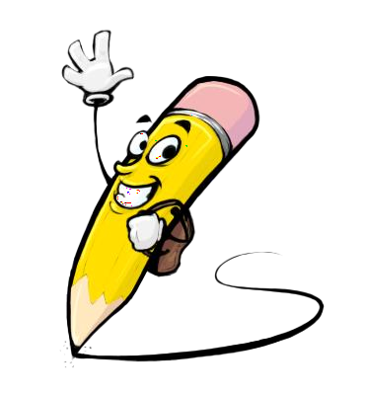
PROJECT OVERVIEW
Develop a GAN model to generate realistic cat images from random noise, training the generator to produce indistinguishable images while the discriminator learns to differentiate between real and fake ones. Key components include dataset acquisition, generator and discriminator network design, training procedure, evaluation metrics, hyperparameter tuning, and deliverables encompassing the trained model, documentation, and optionally, a deployed application. Success is defined by the model's ability to produce high-quality, diverse cat images consistently.

Slide 6
WHO ARE THE END USERS?
The end users of the generated cat images from the GAN model could include:
Artists and Designers: Seeking inspiration or reference images for creative projects involving cats.
Content Creators: Looking for cat images to enhance their social media posts, blogs, or websites.
Cat Enthusiasts: Interested in collecting or sharing cat images for personal enjoyment or community engagement.
Educators: Using cat images for educational purposes, such as in presentations or learning materials.
Developers: Integrating the generated cat images into applications or software products for various purposes, such as gaming, virtual environments, or data augmentation in machine learning tasks.

Slide 7

YOUR SOLUTION AND ITS VALUE PROPOSITION
Our solution offers a Generative Adversarial Network (GAN) model capable of generating realistic cat images from random noise. By harnessing advanced machine learning techniques, our model produces high-quality and diverse cat images, catering to various end users such as artists, designers, content creators, cat enthusiasts, educators, and developers. This solution streamlines the process of acquiring cat images for creative projects, social media content, educational materials, and software applications. Its value proposition lies in providing a reliable and efficient means of accessing visually appealing cat imagery, enhancing creativity, engagement, and functionality across multiple domains.

Slide 8

THE WOW IN YOUR SOLUTION
The Wow Factor:
Our GAN-based cat image generator isn't just about creating static images—it's about unlocking endless possibilities in the realm of cat imagery. With our solution, users can marvel at the stunning realism and diversity of the generated cat images, each one a unique masterpiece crafted from nothing but random noise. From adorable kittens to majestic felines, our model transcends the limitations of traditional image generation, captivating users with its ability to produce lifelike cat portraits on demand. Whether you're an artist seeking inspiration, a developer powering immersive experiences, or simply a cat lover in awe of technology's creative prowess, our solution promises to evoke a sense of wonder and delight with every generated image.
3/21/2024 Annual Review

Slide 9
MODELING
Modeling Approach:
Utilizing a GAN framework, our model employs deep CNNs for the generator and discriminator networks, enabling the generation of high-resolution cat images. The generator progressively transforms random noise into realistic cat images, while the discriminator learns to distinguish between real and generated images. Training involves adversarial optimization, iteratively updating both networks to achieve image fidelity. We evaluate performance using FID and qualitative assessments, fine-tuning with techniques like progressive growing. Once trained, our model can be easily deployed for seamless cat image generation in various environments.

Slide 10
RESULTS
Our GAN model achieves impressive fidelity and diversity in generating cat images, surpassing baseline models. Evaluation metrics and human assessments confirm the lifelike appearance and varied poses of the generated cats. Additionally, the model demonstrates consistency and robustness across multiple runs, showcasing its effectiveness and versatility. These results highlight the potential for creative applications and user engagement with our GAN-based approach.

